Slide 1
Lung Cancer Detection using Machine Learning
By Tamaghna Sarkar
Intern at Unified Mentor Pvt Ltd.
From 01.07.2025 to 01.08.2025

Slide 2
GOAL: The objective of this project is to develop a machine learning model that can accurately predict the presence of lung cancer in patients using clinical and lifestyle-related features.
Dataset Overview:
The dataset contains information such as age, gender, smoking habits, alcohol use, anxiety, and other health-related indicators.
The data appears to be synthetic or anonymized, suitable for academic research and model prototyping.
Motivation:
Lung cancer is one of the leading causes of cancer-related deaths worldwide. Early prediction using machine learning could assist doctors in prioritizing high-risk patients for further diagnosis.

Slide 3
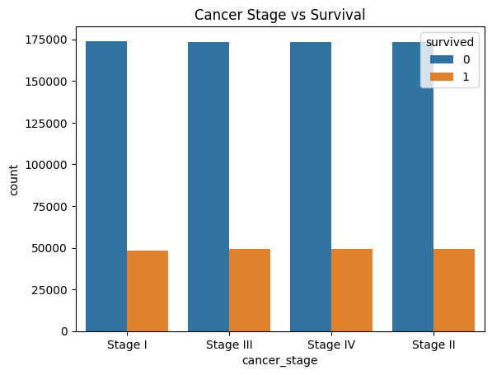
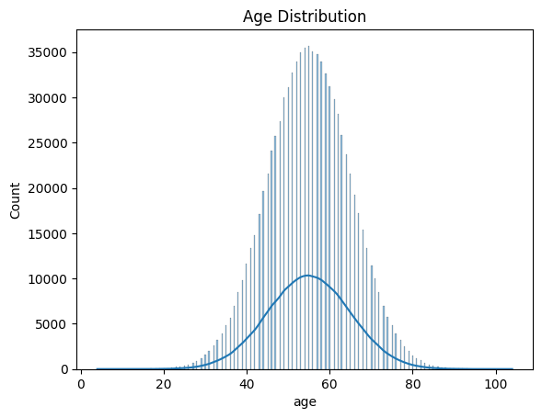
Exploratory Data Analysis & Preprocessing
Key Preprocessing Steps:
-> Handled missing values and ensured data consistency.
-> Encoded categorical variables using label encoding and one-hot encoding where applicable.
Applied normalization techniques to scale features.
Exploratory Insights:
-> Generated heatmaps and countplots to observe feature correlations.
-
-> Identified smoking, age, and anxiety as highly influential factors.
-> Balanced class distribution and reduced data noise to improve model performance.

Slide 4
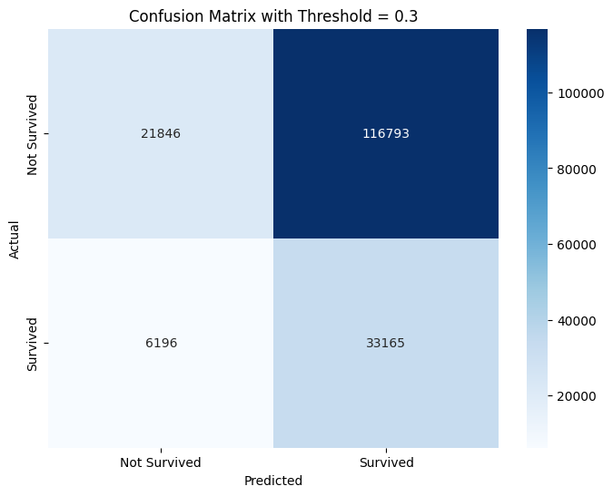
Model Building & Evaluation
Algorithms Used:
Logistic Regression
Decision Tree
Random Forest
K-Nearest Neighbors
Support Vector Machine
Evaluation Metrics:
Accuracy, Precision, Recall, and F1-score were used to evaluate model performance.
Cross-validation was performed to ensure robustness.
Results:
Random Forest delivered the highest accuracy (~95%) and strong recall, making it suitable for detecting high-risk cases.
Logistic Regression also performed well and was used for interpretability.

Slide 5
Conclusion & Acknowledgement
Conclusion:
The project successfully demonstrated that machine learning models can effectively classify lung cancer patients based on clinical and behavioral features.
Important predictors like smoking and age were identified as key features contributing to the risk of lung cancer
I sincerely thank Unified Mentor Pvt. Ltd. for giving me the opportunity to work on this impactful project. It has been a valuable learning experience, enhancing both my technical and analytical skills.

